Slide 1
Social Network Analysis for Marketing Management
Dr. Swagato Chatterjee
VGSoM, IIT Kharagpur

Slide 2
Social Network Analysis: A Background
Term Coined by J.A. Barnes in 1954
Sociometrics
Harvard School
The Manchester School

Slide 3
Common Uses
Diffusion of Ideas and Diseases
Social Influence
Social Support
Overt and Covert Organizational Structure
Marketing and Management
Social Movements

Slide 4
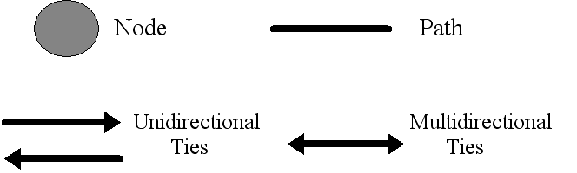
Reading a Social Networks Graph

Slide 5
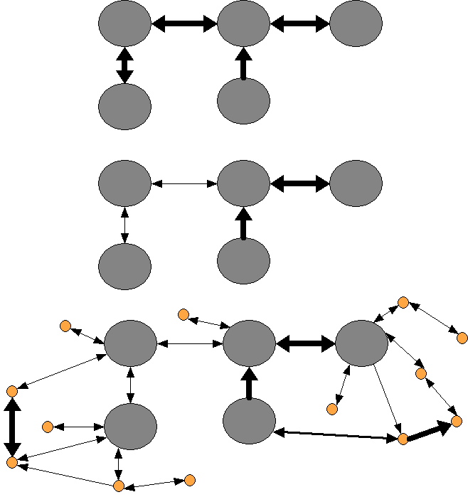
A Simple Network(?)

Slide 6
A Social Networks Data Matrix (face-to-face interaction in a class)
0 1 2 3 4 5 6
1 2 3 4 5 6 7 8 9 1 1 1 1 1 1 1
- - - - - - - - - - - - - - - - - - -
1 - 0 0 3 0 0 0 0 0 6 0 0 0 0 0 0 0
2 - 0 0 0 6 4 0 0 0 0 0 5 0 0 0 0 0
3 - 5 0 0 5 3 3 0 0 6 5 0 1 0 4 1 0
4 - 0 6 5 0 5 3 0 0 5 4 6 2 0 0 0 3
5 - 0 5 5 4 0 2 0 0 1 5 5 0 5 1 0 0
6 - 0 0 5 5 5 0 0 0 5 0 0 0 0 3 0 0
7 - 0 1 0 1 0 0 0 0 0 0 0 0 0 0 1 0
8 - 0 0 0 0 0 0 0 0 0 3 0 0 0 0 0 0
9 - 5 0 6 5 4 4 0 0 0 5 0 0 0 5 0 0
10 - 0 0 5 5 5 0 0 6 5 0 0 2 0 0 0 0
11 - 0 6 3 6 4 0 0 0 0 0 0 0 0 0 0 5
12 - 0 0 1 1 0 0 0 0 0 1 0 0 0 0 0 0
13 - 0 0 1 1 4 1 0 0 0 0 0 0 0 3 0 0 14 - 0 0 4 0 0 2 0 0 4 1 0 0 3 0 0 0
15 - 0 0 0 0 0 0 0 0 0 0 0 0 0 0 0 0
16 - 0 1 0 1 0 0 0 0 0 0 2 0 0 0 0 0

Slide 7
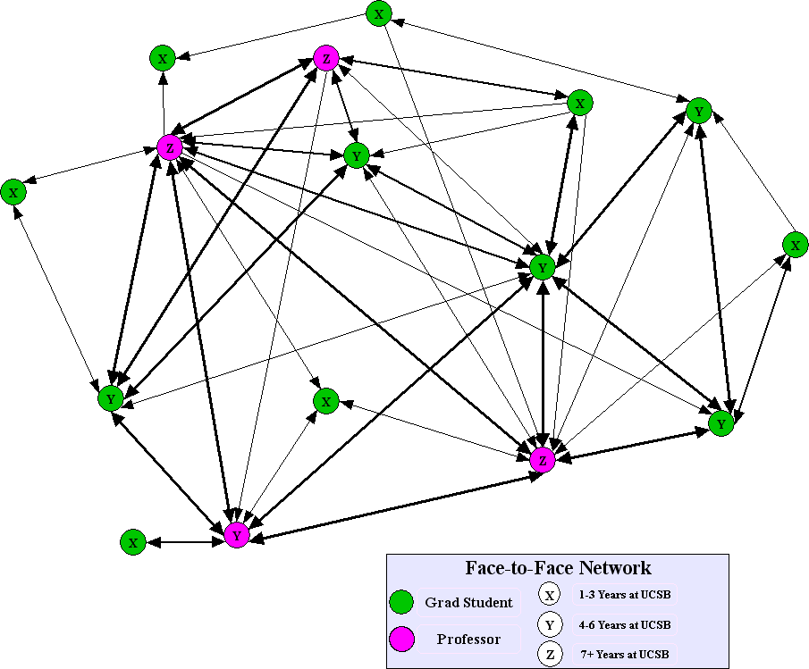
University Class Network

Slide 8
Ties
Actors are networked to each other through ties
The range and type of ties are broad in nature
E.g. are evaluation of one person by another (friendship, liking, or respect)
Transfers of material resources (business transactions, lending or borrowing things)
Associations or affiliations (jointly attending, belonging to the same social club)
Behavourial interactions (talking together, sending messages)
Movement between places or statuses (migration, social or physical mobility)
Biological relations (kin, family, etc.)
Formal relations

Slide 9
Dyads
Tie connects two actors but the tie is the property of the pair and not to any single individual
Some analysis take a pair of individuals and their connections (also known as a dyad) as the unit of analysis
One can observe the possibilities of tie, undirected or directed (which will bring in reciprocity)

Slide 10
Triad
+
+
+
+
-
+
+
-
-

Slide 11
Centrality
One of the earliest ideas that the social network analysts pursued is that of centrality of individuals and organizations in their social networks
The origins of this is the concept of a star – the person who is most popular or who is at the centre

Slide 12
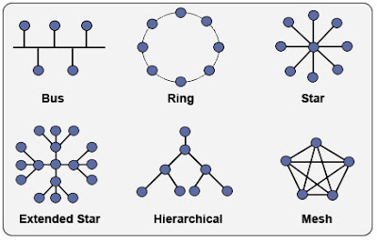

Slide 13
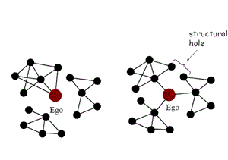
Structural Hole

Slide 14
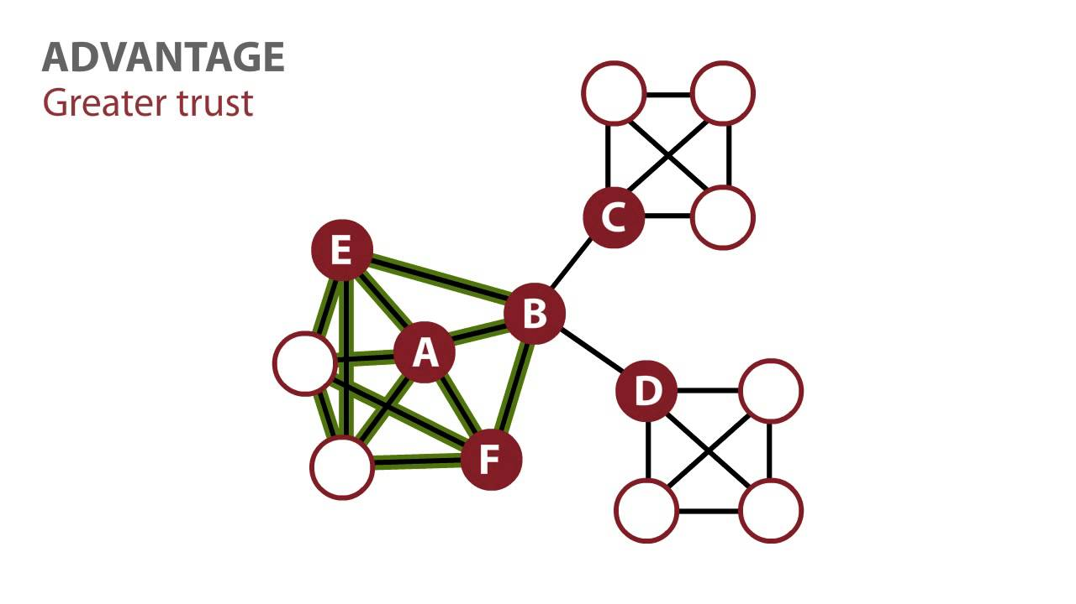

Slide 15
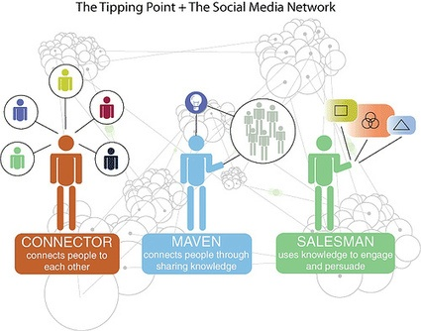

Slide 16
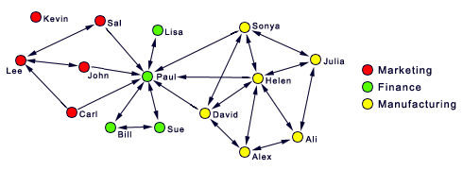

Slide 17
A Manufacturing Company Case Study

Slide 18
Company Background
Global leader in manufacturing integrated circuits
Customers: Automotive, electronic products, IT
2 plants in Thailand, 6000 employees
Customer Oriented
Focus on Complaint Handling

Slide 19
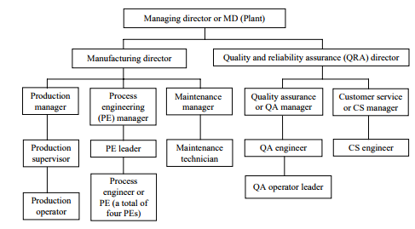

Slide 20
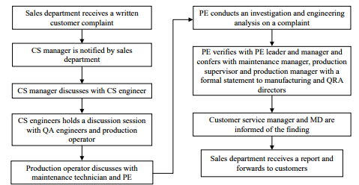

Slide 21
Problem??
80 percent of complaints have taken longer than the targeted timeframe during the past two years.
In an average 15 complaints on the quarterly basis since the last plant expansion
Initial evaluation on the slower than anticipated responses customer complaints points to the ineffectiveness in information sharing

Slide 22
Objective of SNA Study
To examine existing information flows formally and informally within a customer complaint handling process
To identify possible improvement areas to strengthen and improve the effectiveness of this process in the workplace.

Slide 23
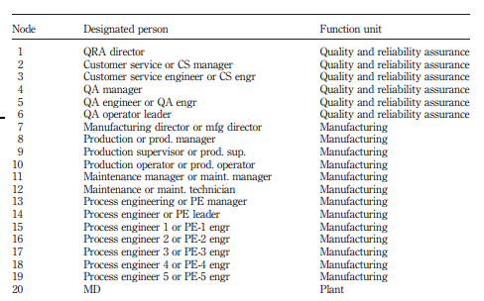
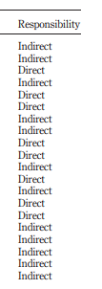

Slide 24
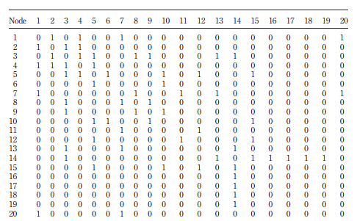


Slide 25
Results

Slide 26
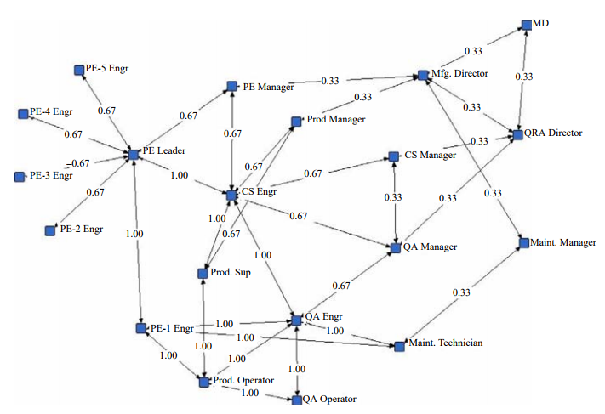

Slide 27
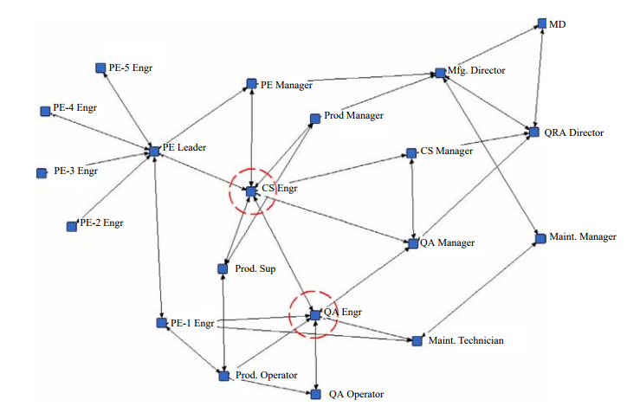

Slide 28
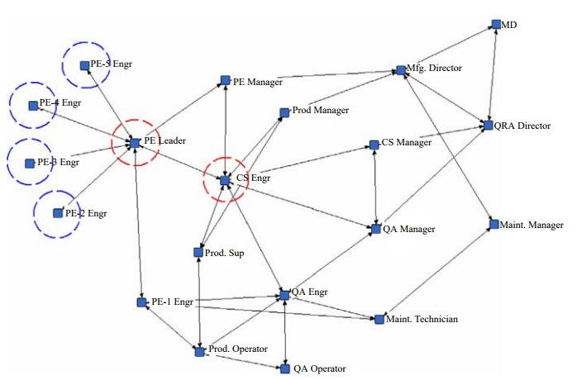

Slide 29
Cast Study 2 - Alphexo

Slide 30
Problem Statement
Alphexo was a major telecom manufacturing company
They implemented logistics related environmental, health and safety (EHS) initiative
Alphexo had an extremely large number of injuries at its distribution center → due to problems in supplier palletizing. Suppliers used out-of-specification pallets that caused injury due to poor quality and breakage
Injuries during pallet disposing, working around pallets and in re-palleitizing process
This has environmental issues as company needed to pay for disposal of the pallets and purchase additional pallets rather than reusing inbound pallets
Create a ER system
Real time reporting to both Alphexo and its suppliers - discrepancies with inbound deliveries
In order to better track supplier performance and communicate supplier quality issues, such as out-of-specification pallets, the ER system was proposed as a solution

Slide 31
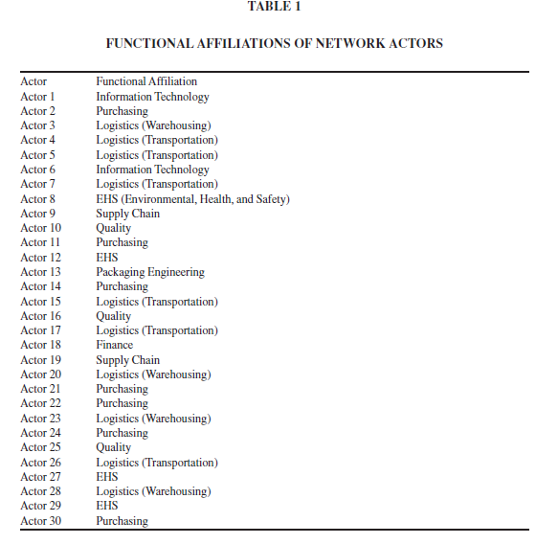

Slide 32
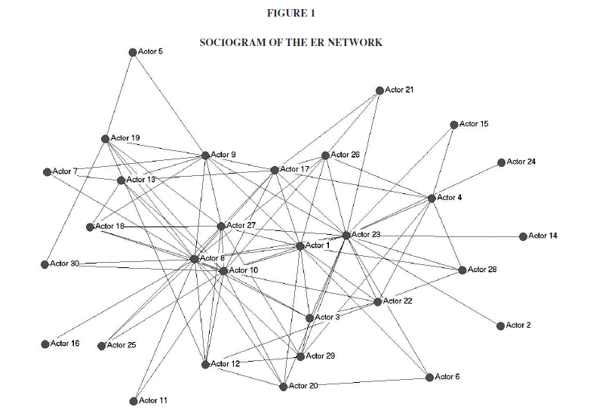

Slide 33
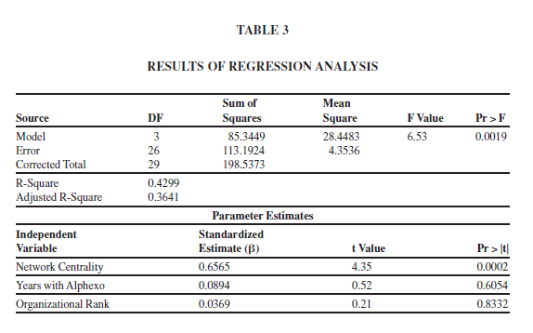

Slide 34
Thank You

